Slide 1
Logistic Regression
Content created by: Mélanie Roschewitz, Pau de Jorge, Chen Chen, Owais Hussain

Slide 2
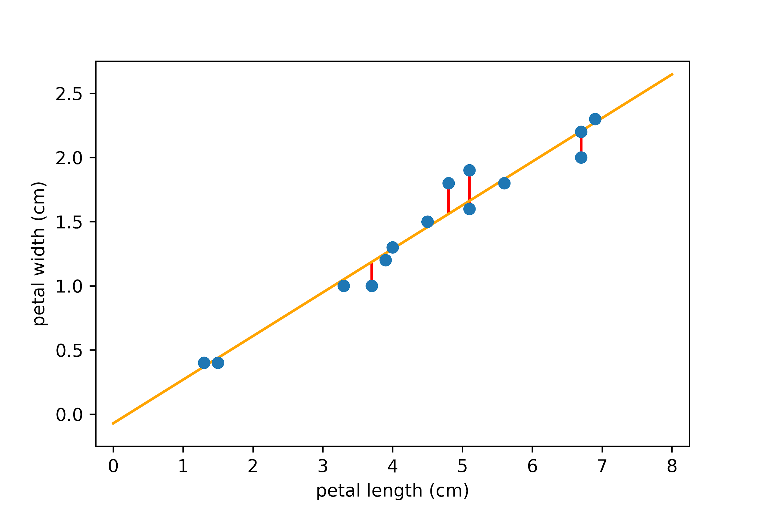
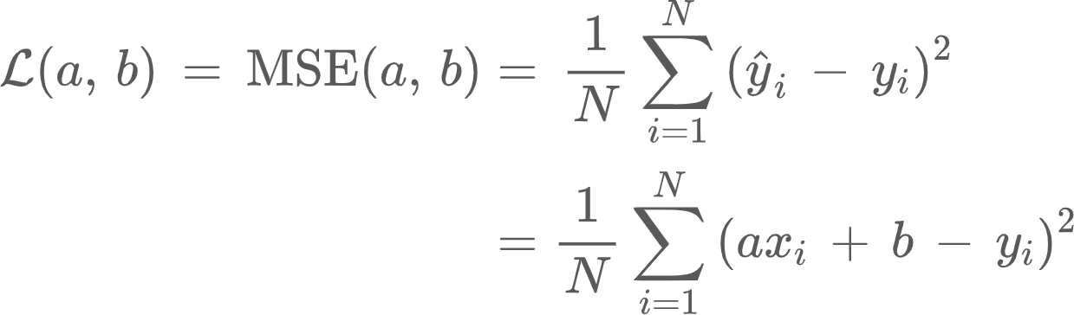
Recap…
We previously focused on regression: where we learn to predict a real value from the input
For example, predict the petal length from the petal width.
Linear Regression = Linear Model + Regression Task

Slide 3
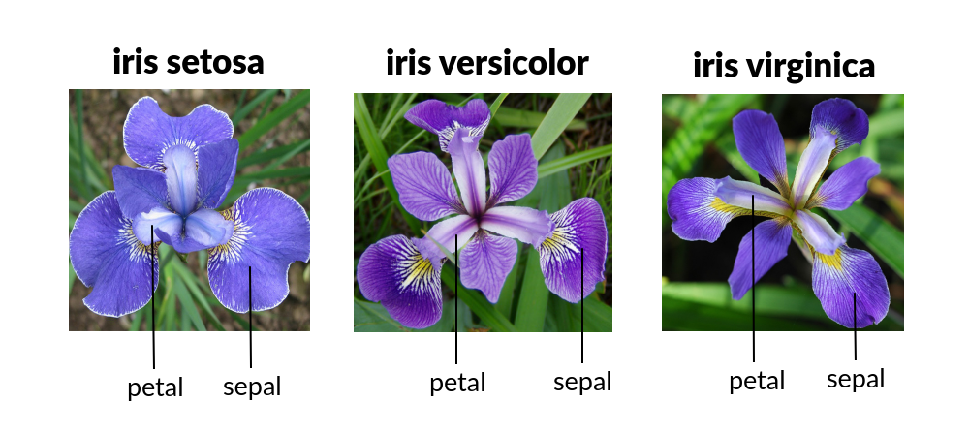
Introduction
This week, we focus on classification
For example, can we predict the species of a flower given its petal length and width?

Slide 4
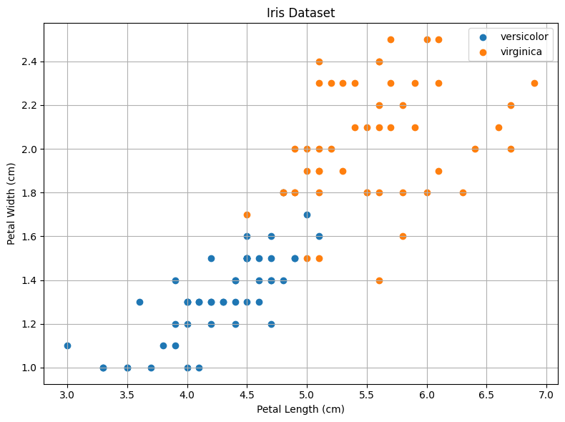
Iris Dataset… again
Let’s look at this Scatter plot and try to understand our data
Here, we have limited the Iris data to only two species for simplicity

Slide 5
Classification
Given Petal width and length, how to identify the species of this new point in grey colour?
Let’s say the Petal width = 1.7 and length = 4.75. Is it Versicolor or Virginica?

Slide 6
Classification
We can make an educated guess by looking for visual closeness and classify as Versicolor. OR look at width and classify as Virginica, since all (except one) Versicolor examples are under 1.7cm

Slide 7
Classification
What if I told you the answer is Versicolor?
And that we are 57% sure that this is the right answer?

Slide 8
Logistic regression for classification

Slide 9
Logistic Regression
Logistic regression is a linear model, in which a line separates classes of data. This line is called decision boundary.

Slide 10
Logistic Regression
Linear Regression and Logistic Regression are both linear models.
One is used to predict continuous data and the other to predict probability of categorical outcomes.

Slide 11
Motivation
Let’s look at an even simpler example…
We want to predict whether a student will pass or fail a test given the number of hours they studied before.
Notes:
Let’s start with an example

Slide 12
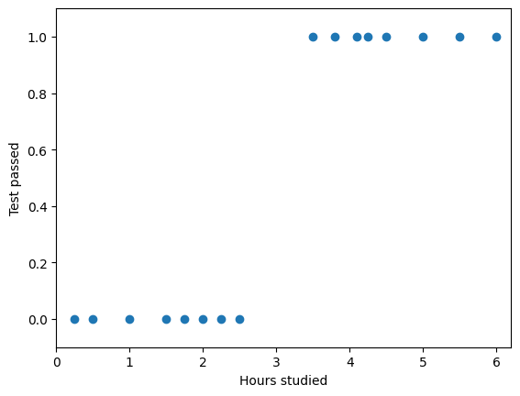
Motivation
We have collected some data from past exams.
Here we only have one feature: ‘hours studied’ to predict our binary target ‘test is passed’.
Will linear regression work?
No!! We are not predicting a real number, instead we would like to predict how likely we are to pass the test, i.e. predict a probability
Notes:
Let’s start with an example

Slide 13
Predicting Probabilities
We want to predict the probability of the student passing the test the number of hours they studied before.
It should have values between 0 and 1
Something like this!

Slide 14
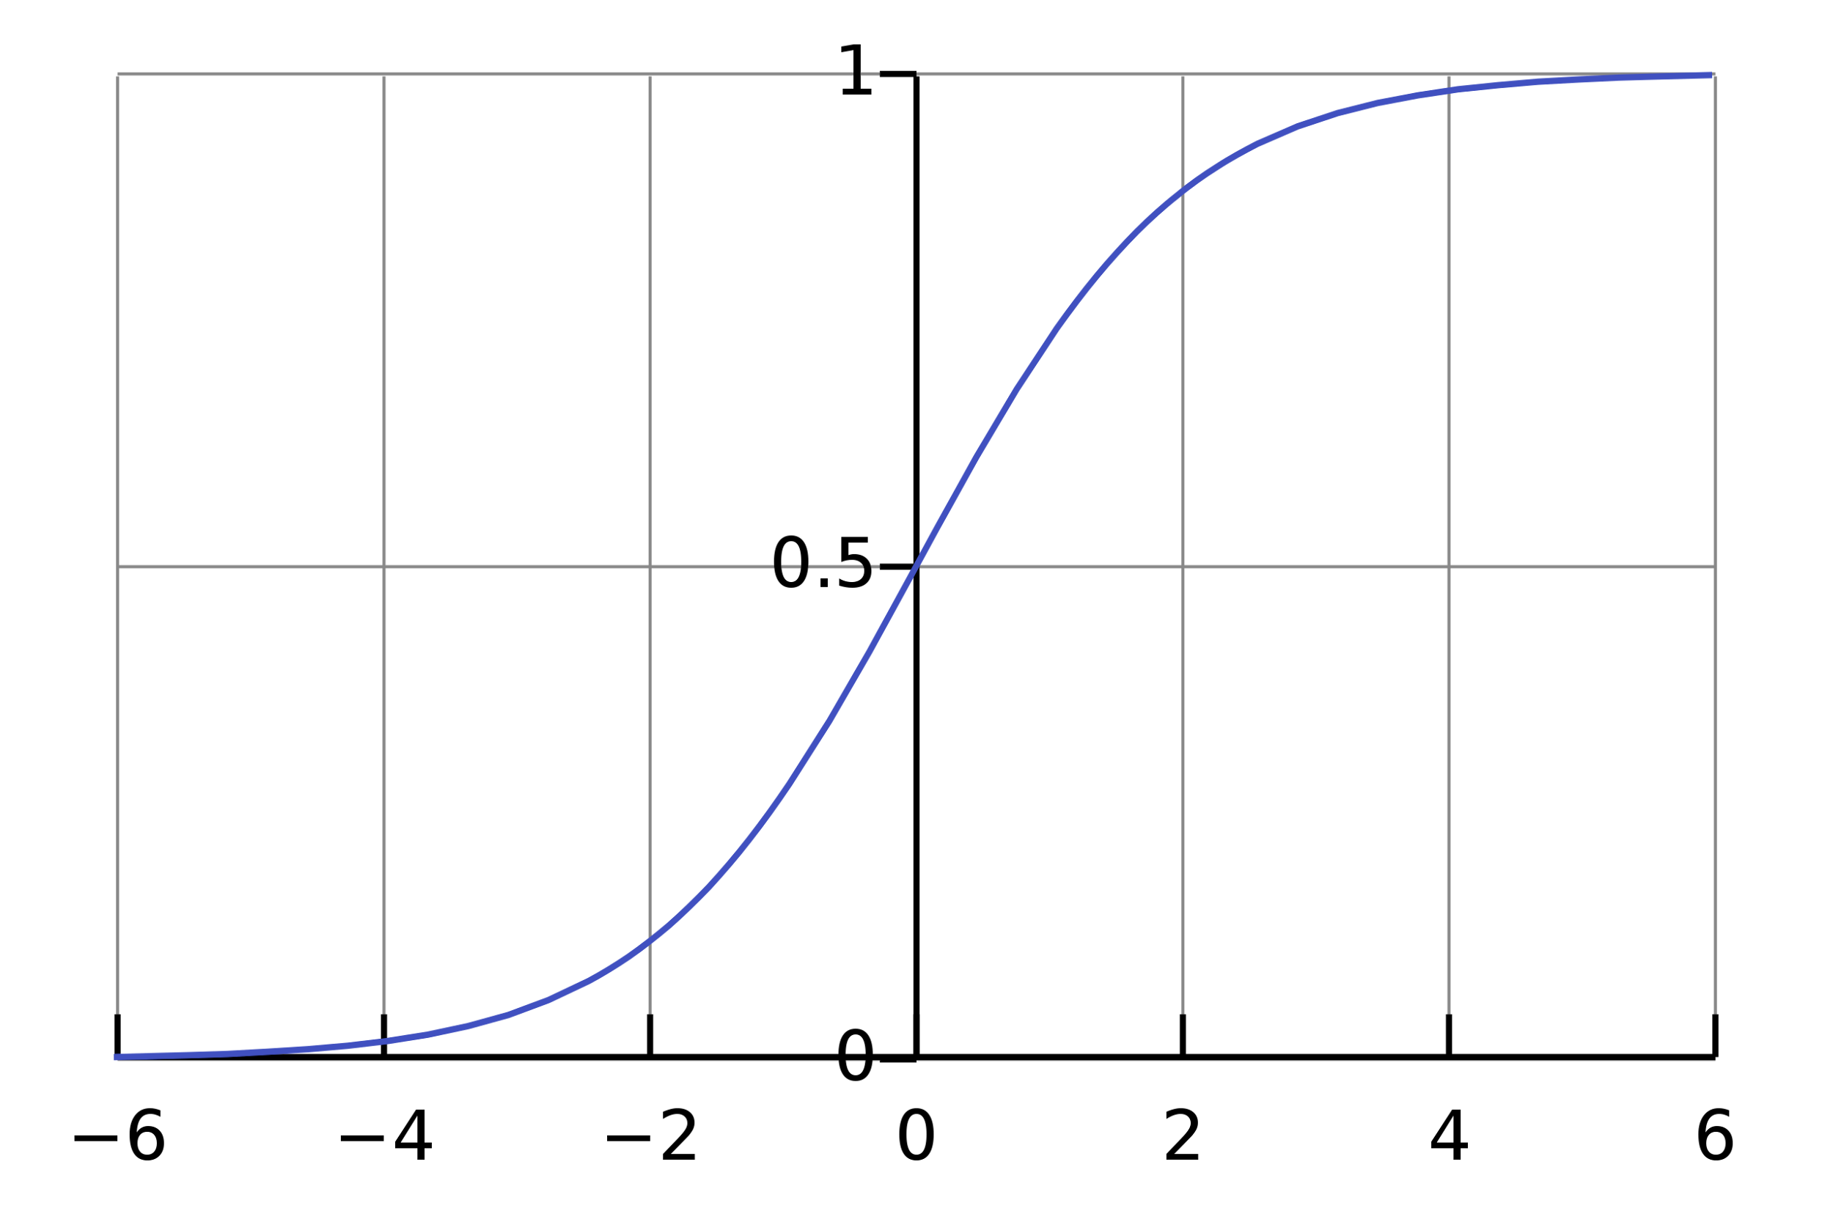
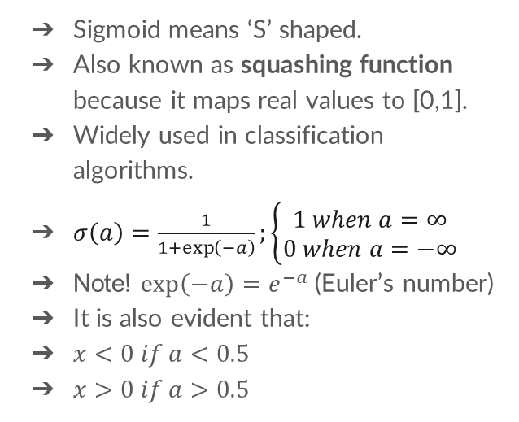
Sigmoid function
Sigmoid means ‘S’ shaped.
Also known as squashing function because it maps real values to [0,1].
Widely used in classification algorithms.
$σ\left(a\right)=\frac{1}{1+\exp\left(−a\right)};\left\{\begin{aligned}1 when a=∞ \\ 0 when a=−∞\end{aligned}\right.$
Note! $\exp\left(−a\right)=e^{−a}$ (Euler’s number)
It is also evident that:
$x<0 if a<0.5$
$x>0 if a>0.5$
Notes:
So instead, we use a sigmoid function, which It transforms any value in the domain to a number between 0 and 1. Note that exp(-a) is exponential function which is also represented as $e^{−a}$ (Base is Euler’s number ~2.178 and $–a$ is exponent)

Slide 15
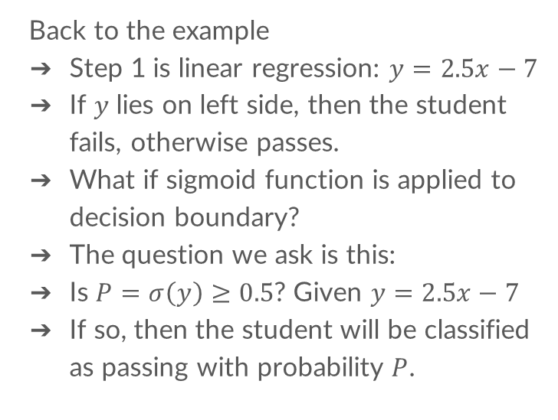
Logistic regression model
Back to the example
Step 1 is linear regression: $y=2.5x−7$
If $y$ lies on left side, then the student fails, otherwise passes.
What if sigmoid function is applied to decision boundary?
The question we ask is this:
Is $P=σ\left(y\right)≥0.5$? Given $y=2.5x−7$
If so, then the student will be classified as passing with probability $P$.

Slide 16
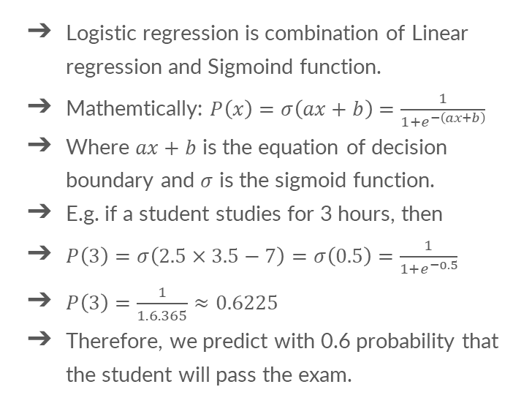
Logistic regression model
Logistic regression is combination of Linear regression and Sigmoind function.
Mathemtically: $P\left(x\right)=σ\left(ax+b\right)=\frac{1}{1+e^{−\left(ax+b\right)}}$
Where $ax+b$ is the equation of decision boundary and $σ$ is the sigmoid function.
E.g. if a student studies for 3 hours, then
$P\left(3\right)=σ\left(2.5×3.5−7\right)=σ\left(0.5\right)=\frac{1}{1+e^{−0.5}}$
$P\left(3\right)=\frac{1}{1.6.365}≈0.6225$
Therefore, we predict with 0.6 probability that the student will pass the exam.

Slide 17
Implementation on Google Colab
Objective 1: Load the Iris dataset into a Pandas data frame and filter out examples where species = ‘Setosa’.
Objective 2: Using Scikit-Learn, fit a Logistic model to predict “species” from “petal width” and “petal length”
Objective 3: Test the model for a few examples and print the predictions with their respective probabilities

Slide 18
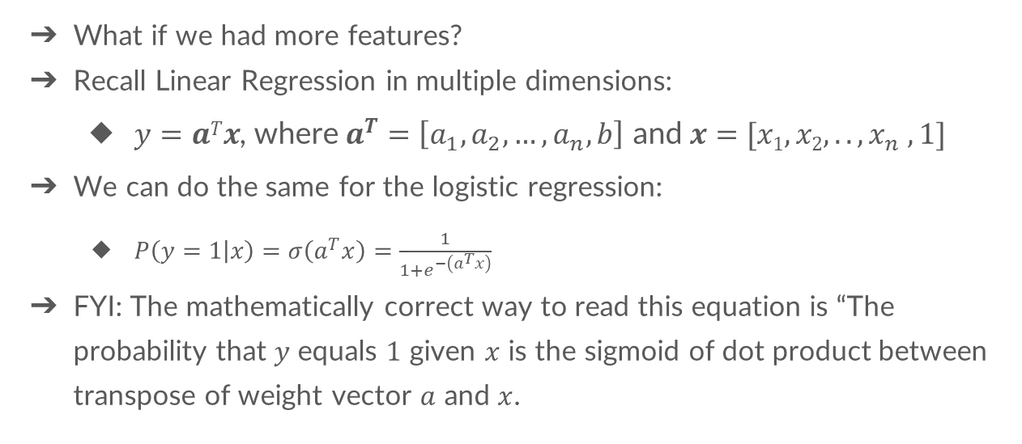
Extension to more dimensions
What if we had more features?
Recall Linear Regression in multiple dimensions:
$y=aTx$, where $a^{T}=\left[a_{1},a_{2},…,a_{n},b\right]$ and $x=[x1,x2,.., x_{n} ,1]$
We can do the same for the logistic regression:
$P\left(y=1 | x\right)=σ\left(a^{T}x\right)=\frac{1}{1+e^{−\left(a^{T}x\right)}}$
FYI: The mathematically correct way to read this equation is “The probability that $y$ equals $1$ given $x$ is the sigmoid of dot product between transpose of weight vector $a$ and $x$.

Slide 19
How to Choose an optimal Line
How to “learn” the “best” line, or the values of $a$ and $b$, a.k.a. weights

Slide 20
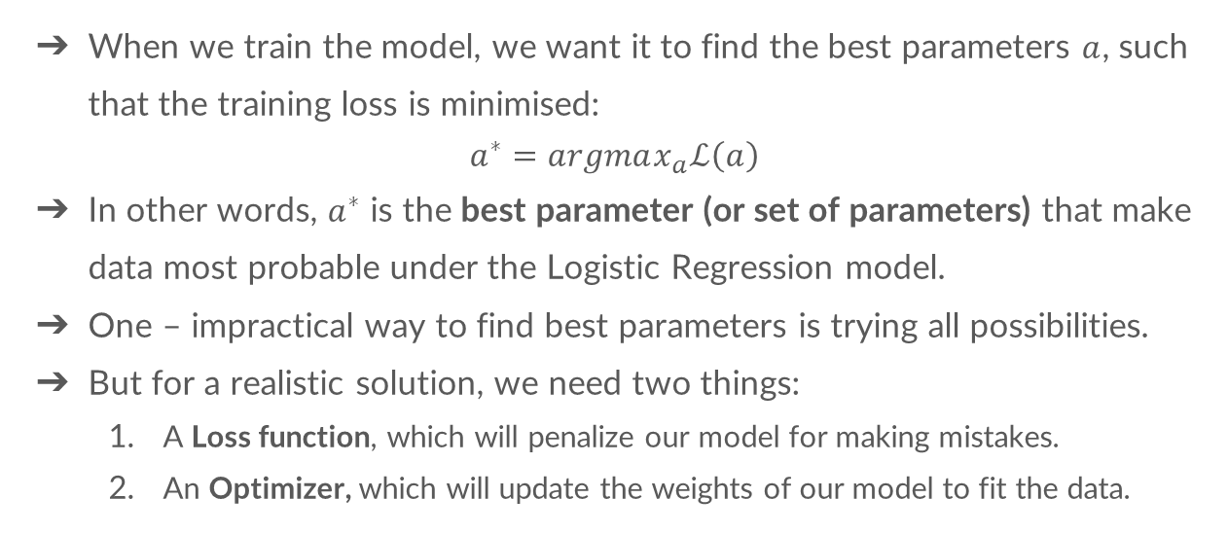
“Learning” by minimizing the loss
When we train the model, we want it to find the best parameters $a$, such that the training loss is minimised:
$$a^{∗}=argmax_{a}ℒ\left(a\right)$$
In other words, $a^{∗}$ is the best parameter (or set of parameters) that make data most probable under the Logistic Regression model.
One – impractical way to find best parameters is trying all possibilities.
But for a realistic solution, we need two things:
A Loss function, which will penalize our model for making mistakes.
An Optimizer, which will update the weights of our model to fit the data.
Notes:
For students with little Mathematical background, explain that there are many ways to draw the regression line, but we are looking for the one that best separates the classes in data

Slide 21
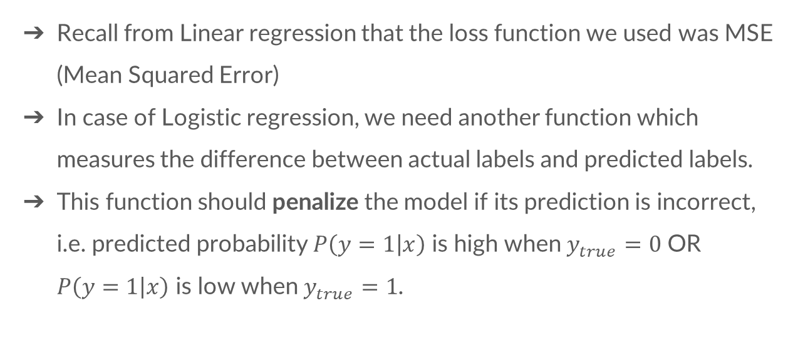
“Learning” by minimizing the loss
Recall from Linear regression that the loss function we used was MSE (Mean Squared Error)
In case of Logistic regression, we need another function which measures the difference between actual labels and predicted labels.
This function should penalize the model if its prediction is incorrect, i.e. predicted probability $P\left(y=1 | x\right)$ is high when $y_{true}=0$ OR $P\left(y=1 | x\right)$ is low when $y_{true}=1$.

Slide 22
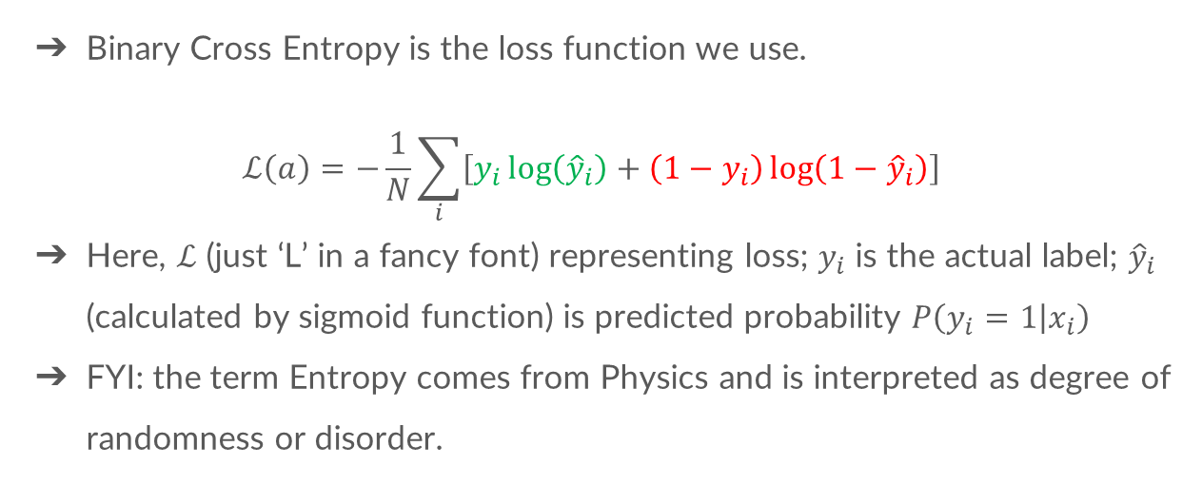
Binary Cross Entropy
Binary Cross Entropy is the loss function we use.
$$ℒ\left(a\right)=−\frac{1}{N}\sum_{i}{\left[y_{i}\log\left({\hat{y}}_{i}\right)+\left(1−y_{i}\right)\log\left(1−{\hat{y}}_{i}\right)\right]}$$
Here, $ℒ$ (just ‘L’ in a fancy font) representing loss; $y_{i}$ is the actual label; ${\hat{y}}_{i}$ (calculated by sigmoid function) is predicted probability $P\left(y_{i}=1 | x_{i}\right)$
FYI: the term Entropy comes from Physics and is interpreted as degree of randomness or disorder.
For Class=1 For Class=0
Notes:
BCE has two components that are summed up, one for negative class and the other for positive class. For negative examples, the term $y_{i}\log\left({\hat{y}}_{i}\right)$ becomes zero since $y_{i}=0$. For positive examples, the term ${(1−y}_{i}) \log\left(1−{\hat{y}}_{i}\right)$ becomes zero since $y_{i}=1$

Slide 23
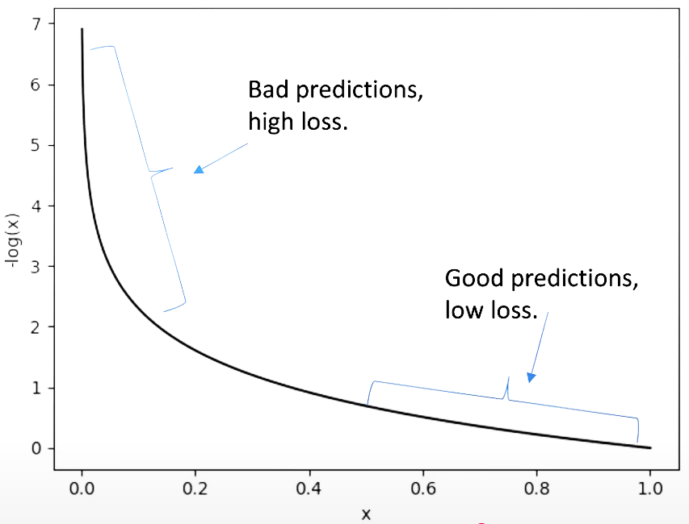
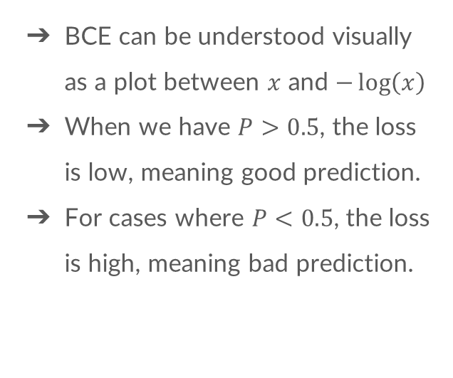
Binary Cross Entropy
BCE can be understood visually as a plot between $x$ and $−\log\left(x\right)$
When we have $P>0.5$, the loss is low, meaning good prediction.
For cases where $P<0.5$, the loss is high, meaning bad prediction.
Notes:
Source: DigitalSreeni (https://www.youtube.com/watch?v=Md4b67HvmRo)

Slide 24
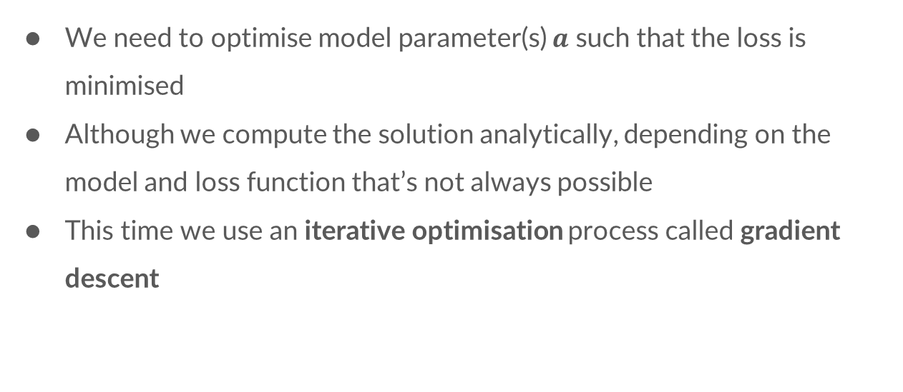
Minimising the loss
We need to optimise model parameter(s) $a$ such that the loss is minimised
Although we compute the solution analytically, depending on the model and loss function that’s not always possible
This time we use an iterative optimisation process called gradient descent

Slide 25
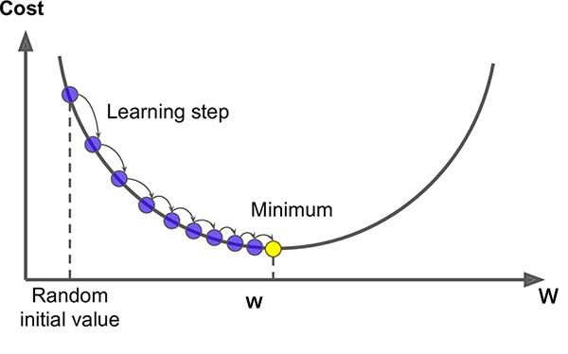
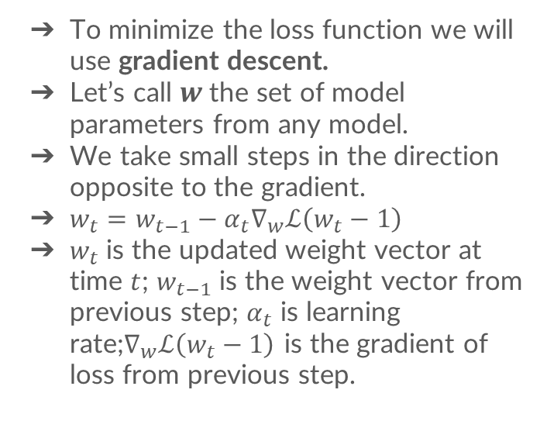
Gradient descent
To minimize the loss function we will use gradient descent.
Let’s call $w$ the set of model parameters from any model.
We take small steps in the direction opposite to the gradient.
$w_{t}=w_{t−1}−α_{t}∇_{w}ℒ\left(w_{t}−1\right)$
$w_{t}$ is the updated weight vector at time $t$; $w_{t−1}$ is the weight vector from previous step; $α_{t}$ is learning rate;$∇_{w}ℒ\left(w_{t}−1\right)$ is the gradient of loss from previous step.

Slide 26
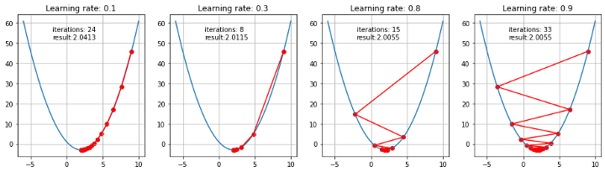
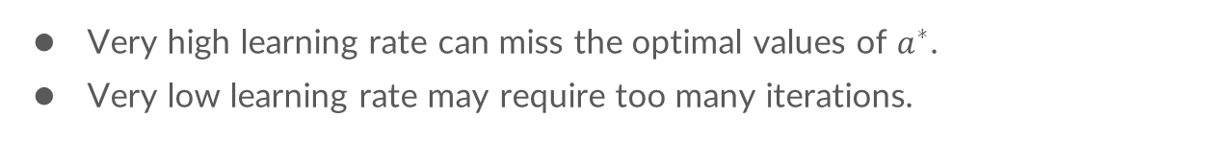
Learning rate matters
Very high learning rate can miss the optimal values of $a^{∗}$.
Very low learning rate may require too many iterations.

Slide 27
Implementation on Google Colab
Objective 1: Calculate Cross-entropy loss of the model trained for Iris data in previous exercie.
Extra: Visualize the decision boundary (use AI to generate code and assess what each line does)

Slide 28
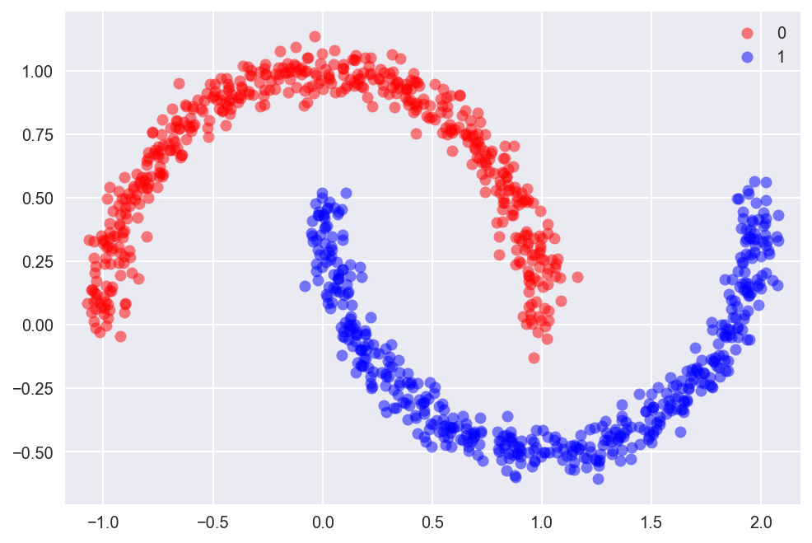
Pros and Cons of Logistic regression
Advantages:
Easy to understand and easy to train
Performs well when the dataset is linearly separable
High interpretability
Disadvantages:
Not suitable for nonlinearly separable datasets
Will overfit if the number of observations is lesser than the number of features

Slide 29
Thank you!
You have completed second milestone in the machine learning domain.
DIY! Prepare a dataset from your income and expenses: date, amount, income_expense, payer_payee, category (food, academic, utility, etc.), balance. You can get some insight from any expense manager app.
Train a Linear regression model to predict your balance at any date.
Train a Logistic regression model to classify whether an expense is recurring or not.
Please share your feedback with us for this week (2mins)!

